Slide 1


OpenSim – Python
Hernandez Vincent

Slide 2

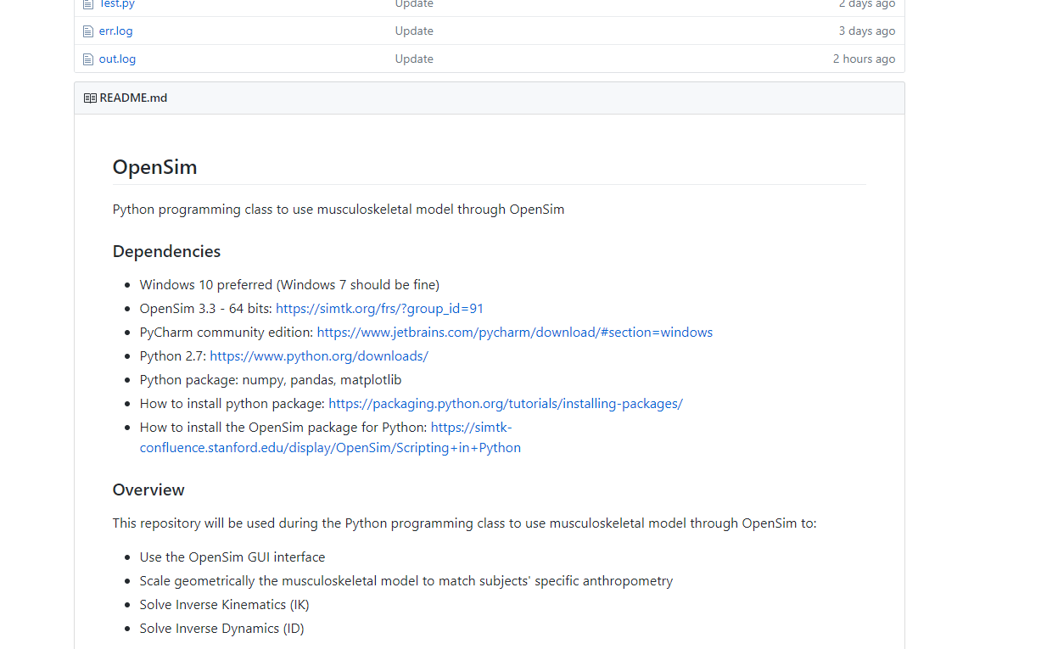
2
GitHub repository
GitHub repository:
https://github.com/GVLABHernandez/OpenSim

Slide 3
3
Inverse Kinematics in OpenSim

Slide 4
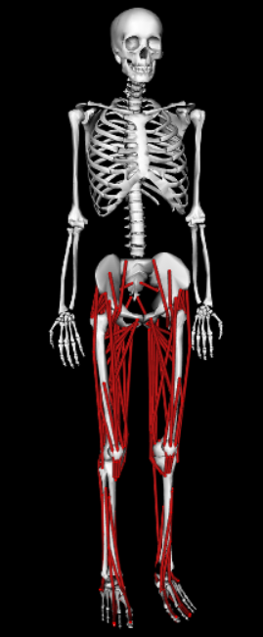
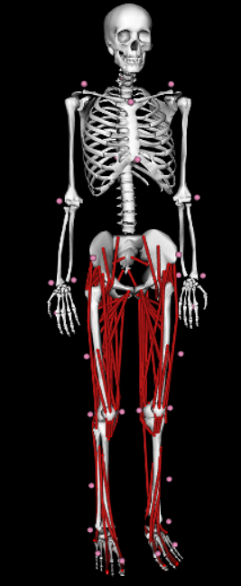
4
Add a markers set

Slide 5
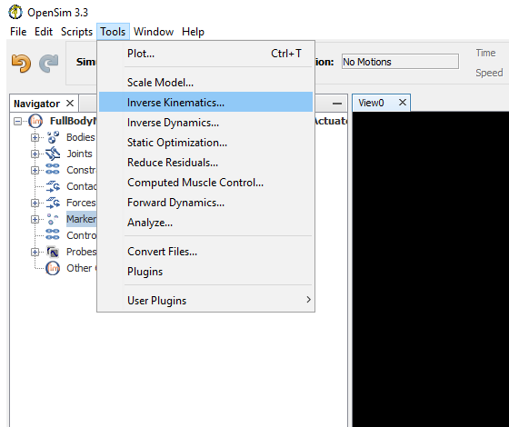
5
Run the Inverse Kinematics

Slide 6
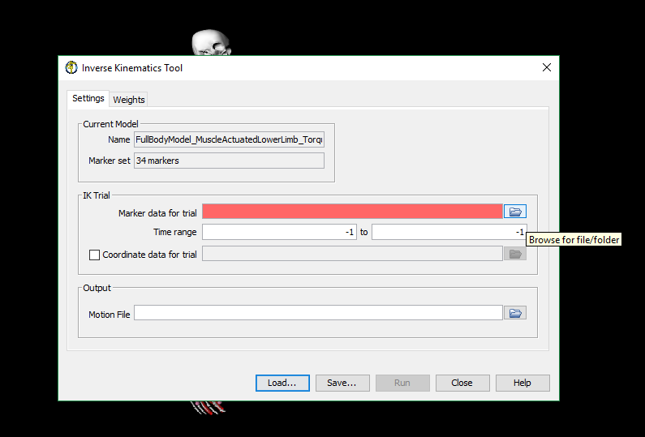
6
Run the Inverse Kinematics
Select one .trc file and click on run

Slide 7
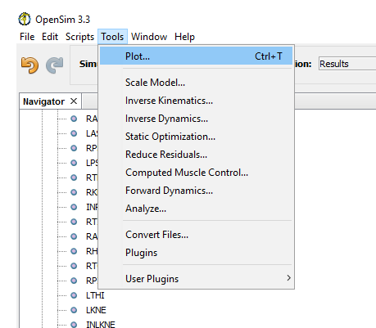
7
Plot the results

Slide 8
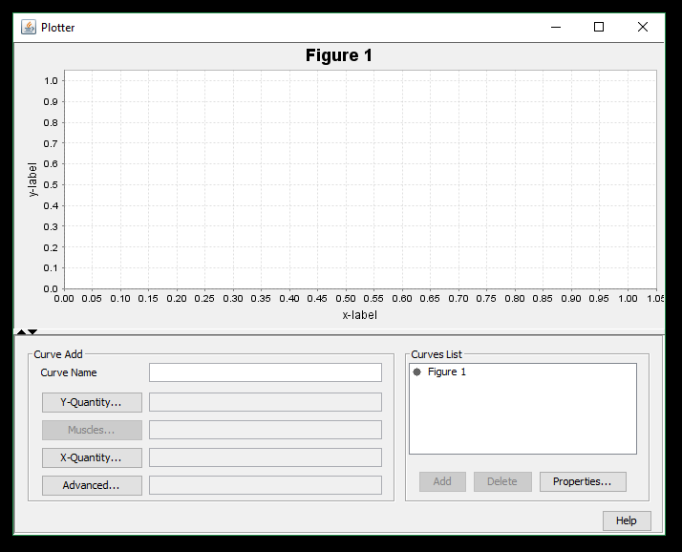
8
Plot the results

Slide 9
9
Inverse Kinematics with Python

Slide 10
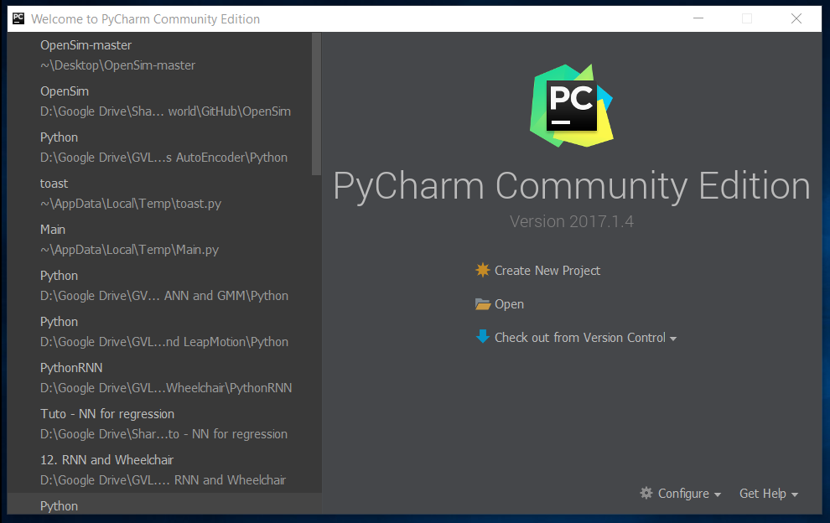
10
OpenSim project
Open PyCharm and click on Open

Slide 11
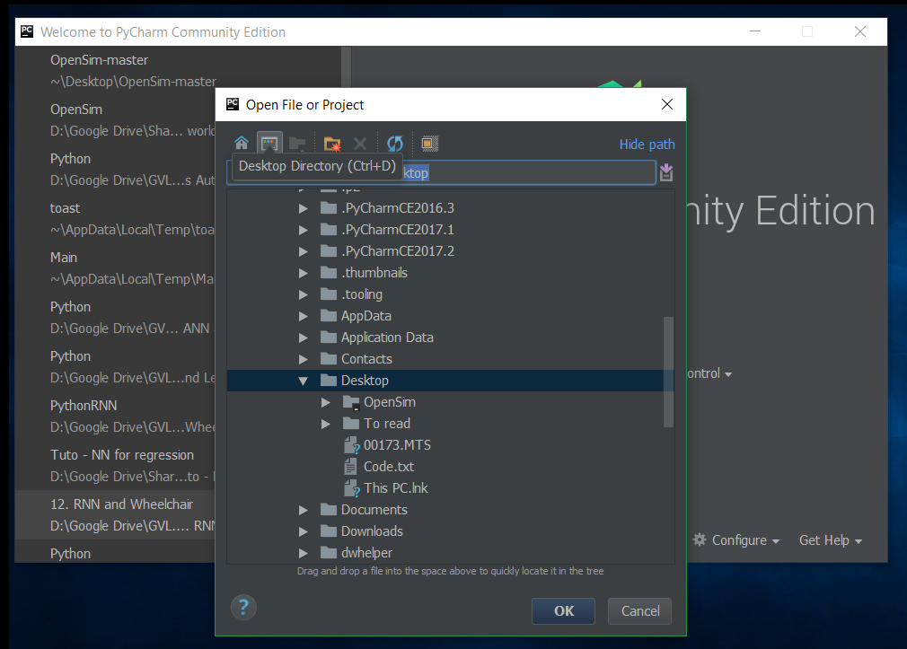
11
OpenSim project
Click on this icon to have access to your desktop

Slide 12
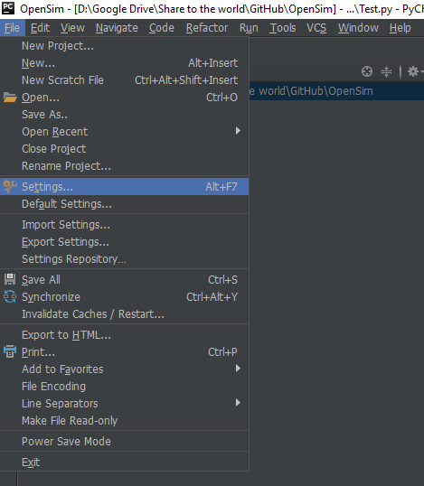
12
OpenSim project
Check the Python interpreter for this project

Slide 13
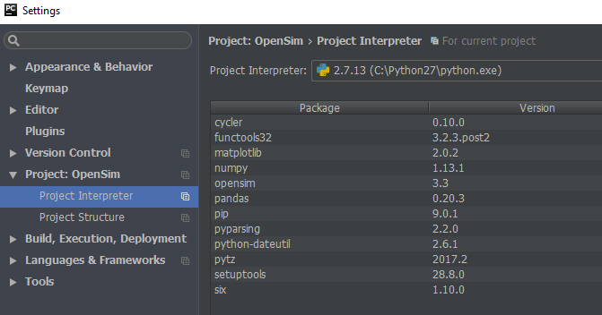
13
OpenSim project
Check the Python interpreter for this project

Slide 14
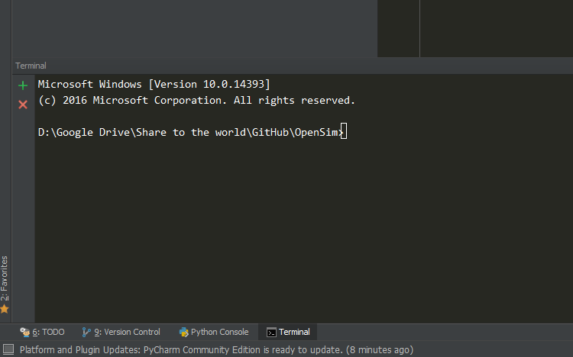
14
Install the python libraries
Python package:
Numpy, matpoltlib and pandas
pip install numpy
(py -2.7 –m pip install numpy)
pip install matplotlib
(py -2.7 –m pip install Matplotlib)
pip install pandas
(py -2.7 –m pip install pandas)

Slide 15
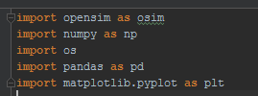
15
Import needed library
This part of the code is used to import the needed libraries
OpenSim: API to connect python and OpenSim
Numpy: use to multi-dimensional arrays and matrices. Large collection of mathematical functions
Pandas: use to create data structures, numeric tables and time-series data
Matplotlib: use to create graphics representation of your data (curve f(x) = y)

Slide 16
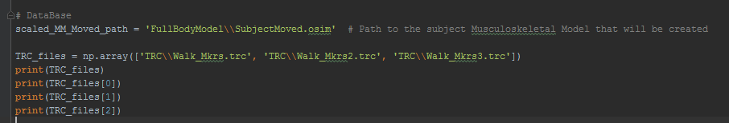
16
IK.py
You can add comment in Python that are used for yourself. It does not influence the execution of the code.
To do so, start your comment with the hash character, # . Everything on the same line after the hash character will be the comment.
A comment can be added at the start of a line or following whitespace or code, but not within a string literal.

Slide 17
17
IK.py
scaled_MM_Moved_path: path to the musculoskeletal model
TRC_files: array of the name of the different .trc files that are in the TRC folder
The function print() is used to display information in the console
To access the first element of the array TRC_files: print(TRC_files[0])

Slide 18
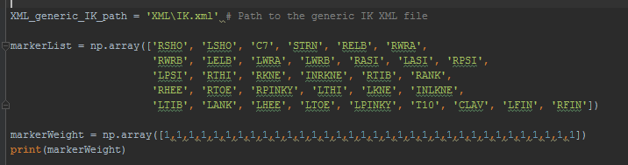
18
IK.py
XML_generic_IK_path: path to the generic Inverse Kinematics .XML file
markerList: marker list that correspond to the market set
markerWeight: determine how "well" the virtual markers track experimental markers (a larger weight will result in less error between the corresponding virtual and experimental marker positions)

Slide 19

19
IK.py
osimModel: We use the path to the musculoskeletal model to create the musculoskeletal model in Python
state: use to initialize the model. This must be called after the Model is fully created but before starting a simulation.

Slide 20
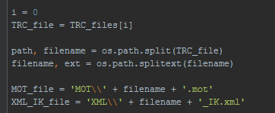
20
IK.py
TRC_file: take the first element of TRC_files[i] with i = 0
os.path.split(TRC_file) and os.path.splitext(filename): use to separate the path, the filename and the extension
Example: 'TRC\\Walk_Mkrs.trc‘ will be separated in 'TRC‘, 'Walk_Mkrs and '.trc‘
MOT_file: name of the .mot file that will contain the result of the IK
XML_IK_file: name of the .xml configuration file that will be used to run the IK

Slide 21

21
IK.py
This part is used to take the information that are contain in the .trc file (data that come from the motion capture system) and decide from what time to what time the simulation should be performed.
Here we choose to run the simulation between the first (getStartFrameTime) and the last frame (getLastFrameTime)

Slide 22
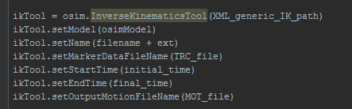
22
IK.py
Create the object ikTool that contain the InverseKinematicsTool:
ikTool = osim.InverseKinematicsTool(XML_generic_IK_path)
Set the Musculoskeletal model: ikTool.setModel(osimModel)
Set the Name and .trc file: ikTool.setName(filename + ext) ikTool.setMarkerDataFileName(TRC_file)

Slide 23
23
IK.py
Set from what time to what time the simulation should be performed: ikTool.setStartTime(initial_time)
ikTool.setEndTime(final_time)
Set the name of the file that will contain the result of the IK: ikTool.setOutputMotionFileName(MOT_file)

Slide 24

24
IK.py
for loops are used when you have a block of code which you want to repeat a fixed number of times.
Every time, the value of j will increase by 1 for a total number of 10 iteration

Slide 25
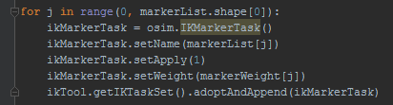
25
IK.py
We are going to use a for loops to iterate through the list of markers (markerList) and the list of weight (markerWeight)
First we create ikMarkerTask that will contain information about the name of the markers (setName), their weights(setWeight), if we apply it or not (setApply).
At first, ikMarkerTask is empty. So wee need to add information in it.
Finally, we add the ikMarkerTask to the ikTool:
ikTool.getIKTaskSet().adoptAndAppend(ikMarkerTask)

Slide 26

26
IK.py
printToXML(XML_IK_file) is used to create the .xml configuration file that contain all need information to run the IK to the XML_IK_file path
Then, we can finally run the IK: ikTool.run()

Slide 27
27
Results
Open Walk_Mkrs.mot file that contain the IK results with Excel
Create one graph with knee_angle_r and the ankle_angle_r in function of the time
Then create another one with the same angle on the left side

